Slide 1
X86 CPU Virtualization
Dr. Amit Praseed

Slide 2

Virtual and Physical CPU
Each guest has a virtual CPU created by the VMM
However, the virtual CPU is only used to store state
E.g. if a guest updates cr3 or eflags, the new value is stored in the virtual CPU
Guest code executes on the physical CPU
Keeps guest performance high
Guests run in userland, so security is maintained
App
App
Guest OS
VM
CPU
Update cr3
VMM
Host OS
PM
CPU
Update cr3

Slide 3
Protected Mode
Most modern CPUs support protected mode
x86 CPUs support three rings with different privileges
Ring 0: OS kernel
Ring 1, 2: device drivers
Ring 3: “userland”
Most OSes only use rings 0 and 3
Ring 3
Ring 2
Ring 1
Ring 0
Kernel
Device Drivers
Device Drivers
Applications
3

Slide 4
Privileged Instructions
OSes rely on many privileges of ring 0
cri, sti, popf – Enable/disable interrupts
hlt – Halt the CPU until the next interrupt
mov cr3, 0x00FA546C – install a page table
Install interrupt and trap handlers
Etc…
However, guests run in userland (ring 3)
VMM must somehow virtualize privileged operations

Slide 5
Using Exceptions for Virtualization
Ideally, when a guest executes a privileged instruction in ring 3, the CPU should generate an exception
Example: suppose the guest executes hlt
The CPU generates a protection exception
The exception gets passed to the VMM
The VMM can emulate the privileged instruction
If guest 1 runs hlt, then it wants to go to sleep
VMM can do guest1.yield(), then schedule guest 2

Slide 6
Types of Machine Instructions
Privileged instructions
Executed in kernel mode
When attempted to be executed in user mode, they cause a trap and so executed in kernel mode.
Non-privileged instructions
Can be executed in user mode
Sensitive instructions
Can be executed in either kernel or user but they behave differently
Require special precautions at execution time.

Slide 7
Issues
Let O be the set of instructions, then O = P ∪ S ∪ I, where
P is the set of Privileged Instructions
Execution in system mode is possible, execution in user mode traps
S is a set of Sensitive instructions, and S = C ∪ B where
C – Control sensitive instructions: Change configuration of system resources
B – Behavior sensitive instructions: Behavior depends on configuration of system resources
I is the set of Insensitive instructions

Slide 8
Issues
Popek and Goldberg theorized that the construction of an efficient VM is possible if S ⊆ P
All sensitive instructions must also be privileged
Sadly, this is not the case with the x86 architecture
17 instructions are sensitive but not privileged
O
P
S

Slide 9
Solutions
Make sure that no sensitive but unprivileged instructions are executed
Instructions are replaced by VMM at runtime
Instructions are replaced before runtime
Adapting the guest OS
Hardware becomes virtualization-aware
Add new instructions for virtualization
Add new mode for virtualization
Orthogonal to traditional modes
New mode “above” system mode (even more privileged)
Example: AMD-V, Intel VT-x, ARM Virtualization Extensions as an extension of ARMv7

Slide 10
Binary Translation
x86 assembly cannot be virtualized because some privileged instructions don’t generate exceptions
Workaround: translate the unsafe assembly from the guest to safe assembly
Known as binary translation
Performed by the VMM
Privileged instructions are changed to function calls to code in VMM

Slide 11
Binary Translation Example
Guest OS Assembly
Translated Assembly
do_atomic_operation:
cli
mov eax, 1
xchg eax, [lock_addr]
test eax, eax
jnz spinlock
…
…
mov [lock_addr], 0
sti
ret
do_atomic_operation:
call [vmm_disable_interrupts]
mov eax, 1
xchg eax, [lock_addr]
test eax, eax
jnz spinlock
…
…
mov [lock_addr], 0
call [vmm_enable_interrupts]
ret

Slide 12
Pros and Cons
Advantages of binary translation
It makes it safe to virtualize x86 assembly code
Translation occurs dynamically, on demand
No need to translate the entire guest OS
App code running in the guest does not need to be translated
Disadvantages
Translation is slow
Wastes memory (duplicate copies of code in memory)
Translation may cause code to be expanded or shortened
Thus, jmp and call addresses may also need to be patched

Slide 13
Caching Translated Code
Typically, VMMs maintain a cache of translated code blocks
LRU replacement
Thus, frequently used code will only be translated once
The first execution of this code will be slow
Other invocations occur at native speed

Slide 14
The Paravirtualized Solution
No privileged instructions are run by the guest OS
OS is modified – virtualization aware
Executes hypercalls to the hypervisor instead of system calls
Hypervisor executes the required privileged instruction safely

Slide 15
Timing in OS
Maintaining time is crucial for an OS
Job deadlines
Task switching
Real time operating systems especially have strict deadlines for tasks
In a non-virtualized scenario, this is not an issue, as the OS only needs to maintain a single time value – the wallclock time (or real time)

Slide 16
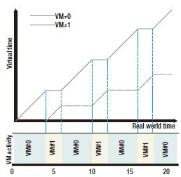
Real vs Virtual Time
In a virtualized scenario, there are two concepts of time
Real time (or wall-clock time)
Virtual Time for different OS
A virtual machine's virtual time advances only while the VM (here VM#0 or VM#1) is active

Slide 17
VM Scheduling
A scheduling algorithm should be efficient, fair, and starvation-free.
The objectives of a scheduler for a batch system are to maximize the throughput (the number of jobs completed in one unit of time, e.g., in one hour) and to minimize the turnaround time (the time between job submission and its completion).
The objectives of a real-time system scheduler are to meet the deadlines and to be predictable.

Slide 18
Fairness in Scheduling
Max-Min Fairness Criterion: Consider a resource with bandwidth B shared among n users who have equal rights. Each user requests an amount bi and receives Bi . Then, according to the max-min criterion, the following conditions must be satisfied by a fair allocation:
The amount received by any user is not larger than the amount requested, Bi ≤ bi .
If the minimum allocation of any user is Bmin no allocation satisfying condition 1 has a higher Bmin than the current allocation.
When we remove the user receiving the minimum allocation Bmin and then reduce the total amount of the resource available from B to (B − Bmin), the condition 2 remains recursively true.

Slide 19
Start Time Fair Queuing Algorithm
Hierarchical CPU scheduler
Organize the consumers of the CPU bandwidth in a tree structure
the root node is the processor
leaves of this tree are the threads of each application.
A scheduler acts at each level of the hierarchy

Slide 20
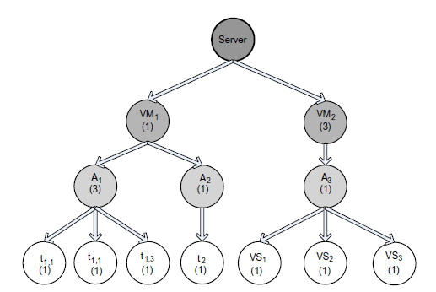
Start Time Fair Queuing Algorithm

Slide 21
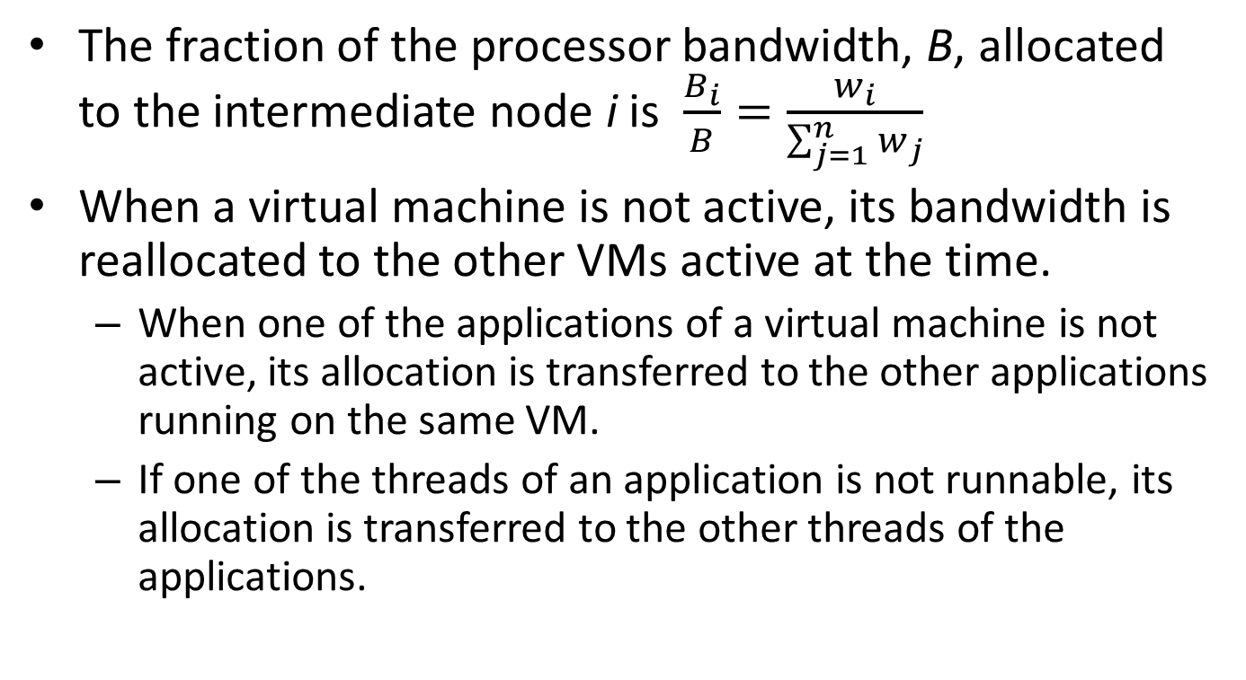
Start Time Fair Queuing Algorithm
The fraction of the processor bandwidth, B, allocated to the intermediate node i is $\frac{B_{i}}{B}=\frac{w_{i}}{\sum_{j=1}^{n}{w_{j}}}$
When a virtual machine is not active, its bandwidth is reallocated to the other VMs active at the time.
When one of the applications of a virtual machine is not active, its allocation is transferred to the other applications running on the same VM.
If one of the threads of an application is not runnable, its allocation is transferred to the other threads of the applications.

Slide 22
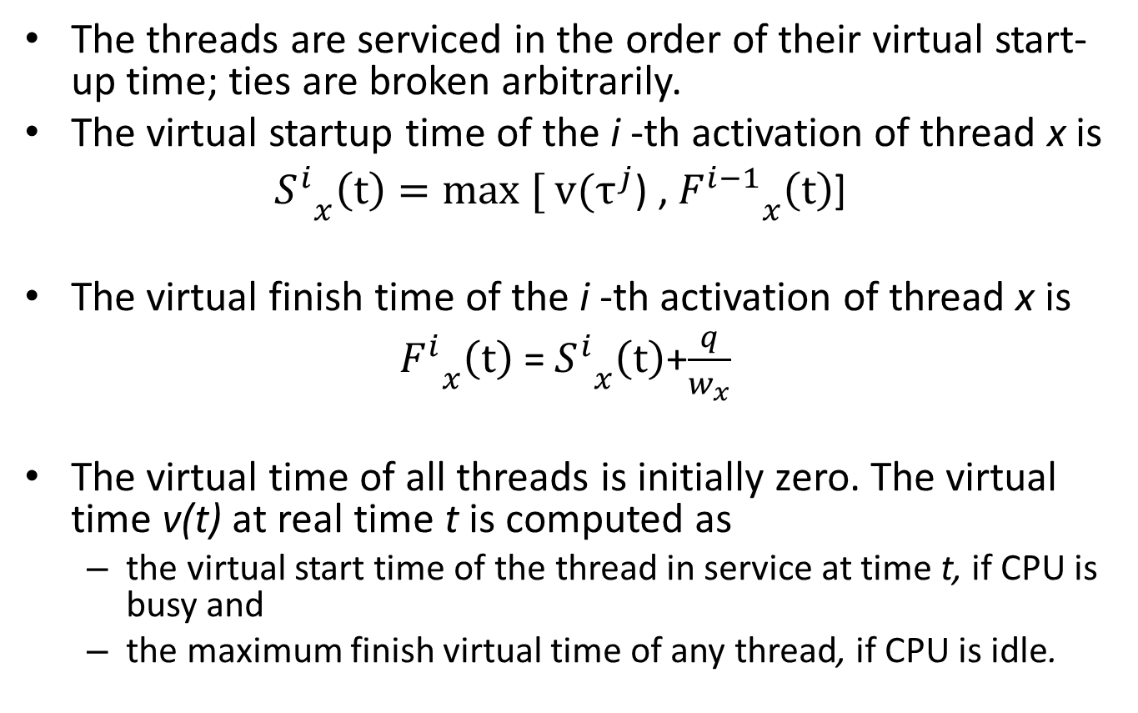
STFQ Scheduling Rules
The threads are serviced in the order of their virtual start-up time; ties are broken arbitrarily.
The virtual startup time of the i -th activation of thread x is
${S_{}^{i}}_{x}\left(t\right)=max [ v(τ^{j}$) , ${F_{}^{i−1}}_{x}\left(t\right)$]
The virtual finish time of the i -th activation of thread x is
${F_{}^{i}}_{x}\left(t\right)$ = ${S_{}^{i}}_{x}\left(t\right)$+$\frac{q}{w_{x}}$
The virtual time of all threads is initially zero. The virtual time v(t) at real time t is computed as
the virtual start time of the thread in service at time t, if CPU is busy and
the maximum finish virtual time of any thread, if CPU is idle.

Slide 23
Borrowed Virtual Time (BVT) Scheduling
Objectives of BVT
Support low-latency dispatching of real-time applications
weighted sharing of the CPU among several classes of applications
supports scheduling of a mix of applications, some with hard, some with soft real-time constraints, and applications demanding only a best effort.

Slide 24
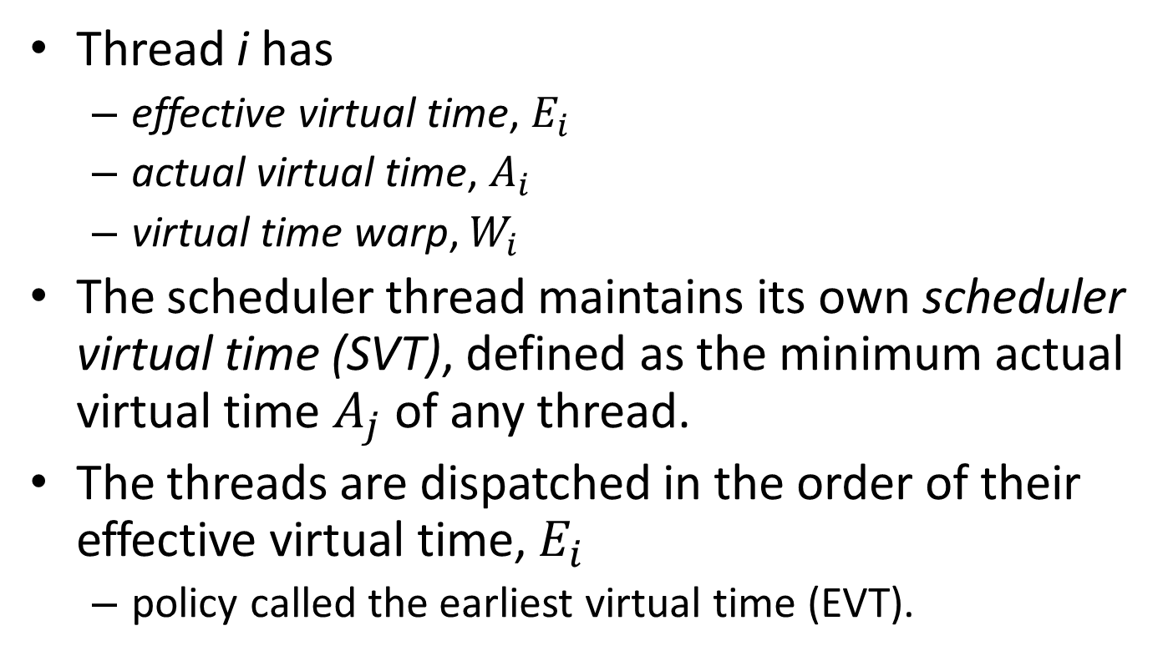
Basics of BVT Scheduling
Thread i has
effective virtual time, $E_{i}$
actual virtual time, $A_{i}$
virtual time warp, $W_{i}$
The scheduler thread maintains its own scheduler virtual time (SVT), defined as the minimum actual virtual time $A_{j}$ of any thread.
The threads are dispatched in the order of their effective virtual time, $E_{i}$
policy called the earliest virtual time (EVT).

Slide 25
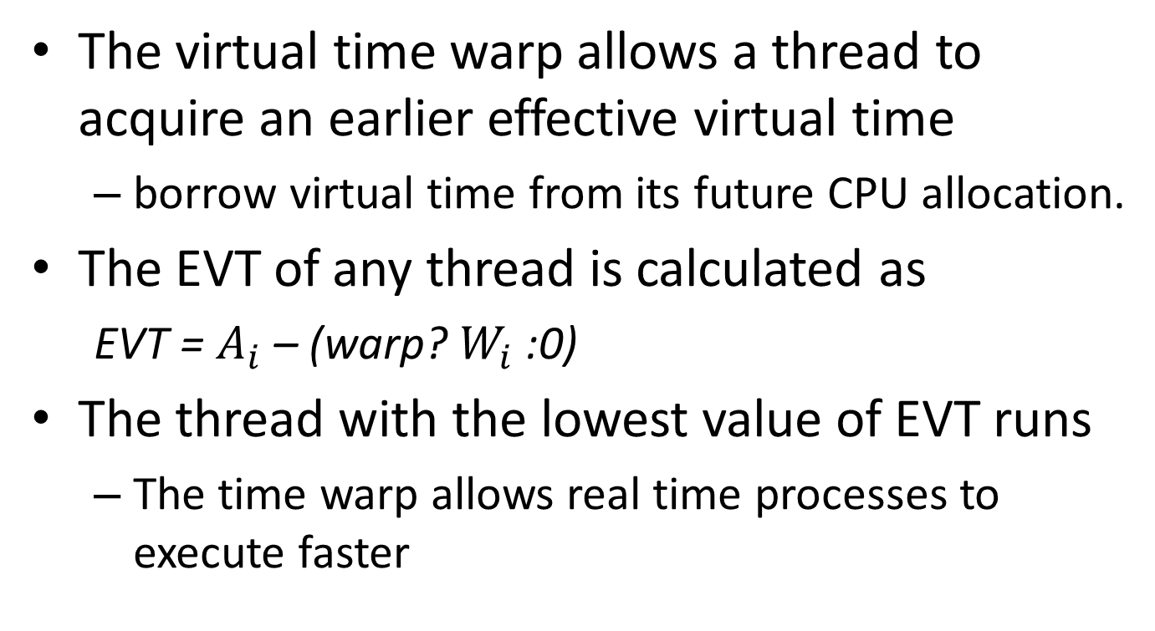
Basics of BVT Scheduling
The virtual time warp allows a thread to acquire an earlier effective virtual time
borrow virtual time from its future CPU allocation.
The EVT of any thread is calculated as
EVT = $A_{i}$ – (warp? $W_{i}$:0)
The thread with the lowest value of EVT runs
The time warp allows real time processes to execute faster

Slide 26
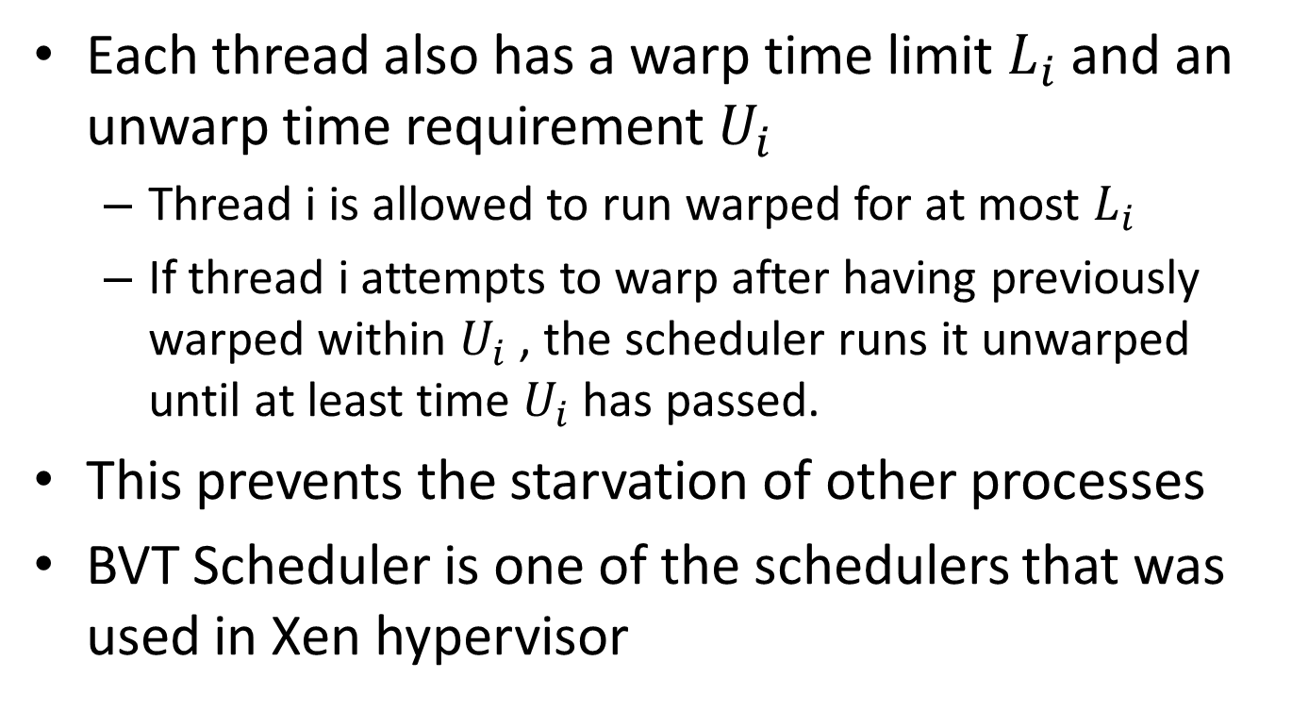
Basics of BVT Scheduling
Each thread also has a warp time limit $L_{i}$ and an unwarp time requirement $U_{i}$
Thread i is allowed to run warped for at most $L_{i}$
If thread i attempts to warp after having previously warped within $U_{i}$ , the scheduler runs it unwarped until at least time $U_{i}$ has passed.
This prevents the starvation of other processes
BVT Scheduler is one of the schedulers that was used in Xen hypervisor

